Slide 1
Online Food delivery system UML diagrams
Team Members:
Shreeman R - 18BTRSE025
Srijan Kumar Srivastava - 18BTRSE028
T Aswin Barath - 18BTRSE031
Vyshnav Raj - 18BTRSE033

Slide 2
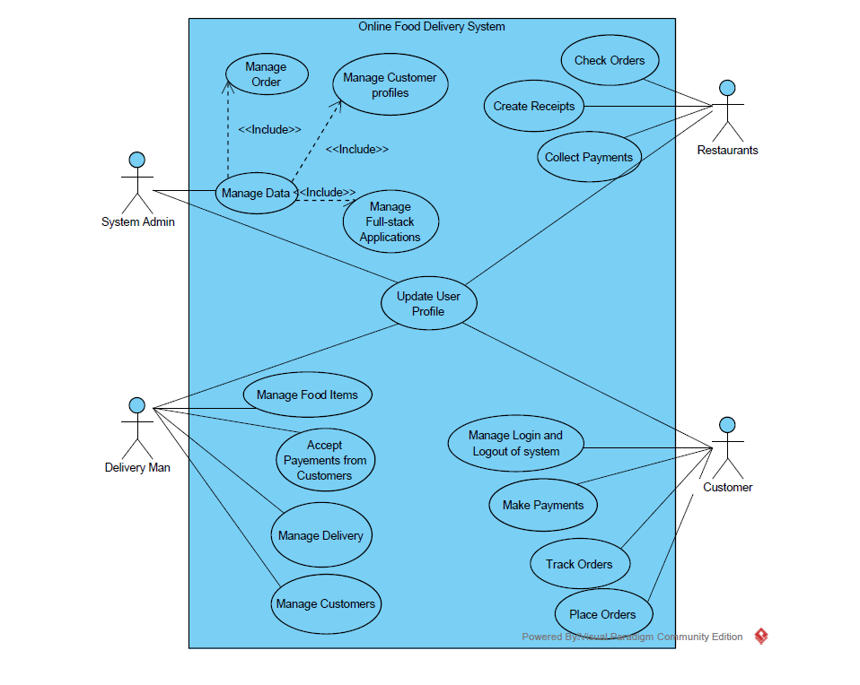
Use Case Diagram

Slide 3
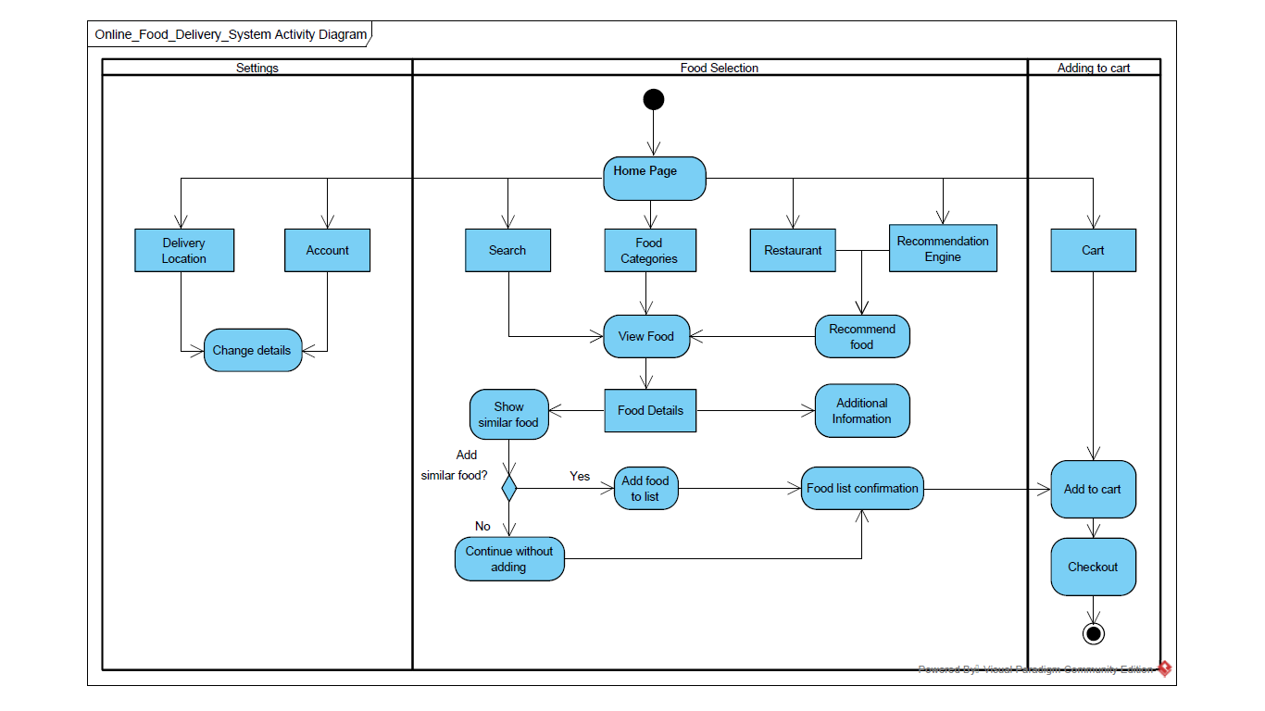
Activity Diagram

Slide 4
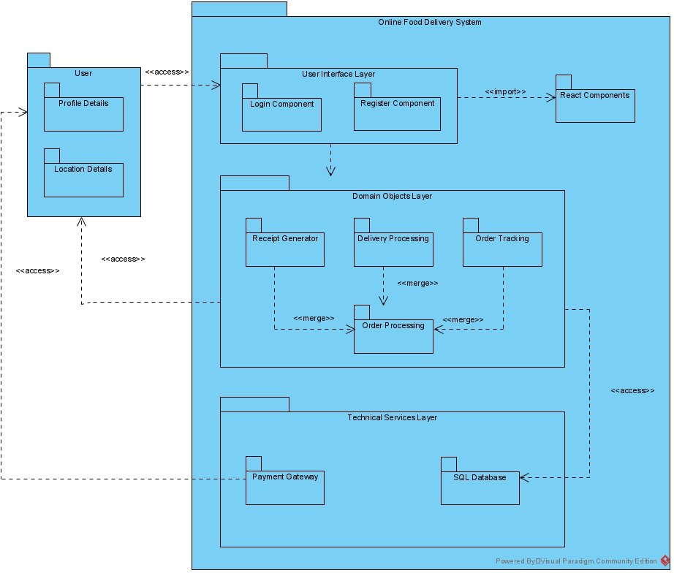
Logical architecture diagram with UML package diagram notation: 1) User interface layer 2) Domain Objects layer 3) Technical services layer

Slide 5
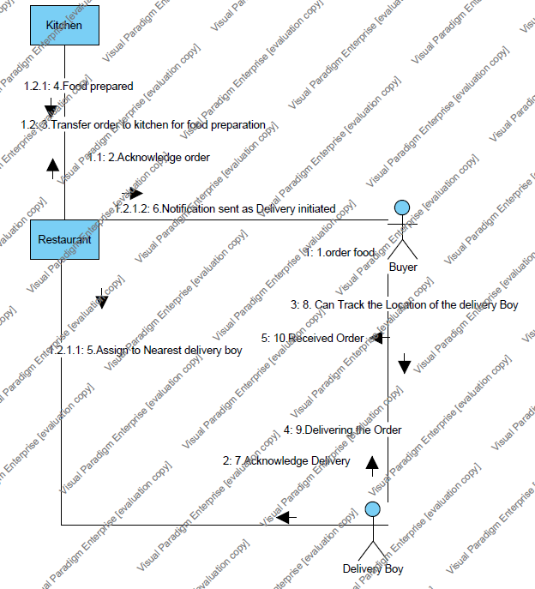
Communication diagram

Slide 6
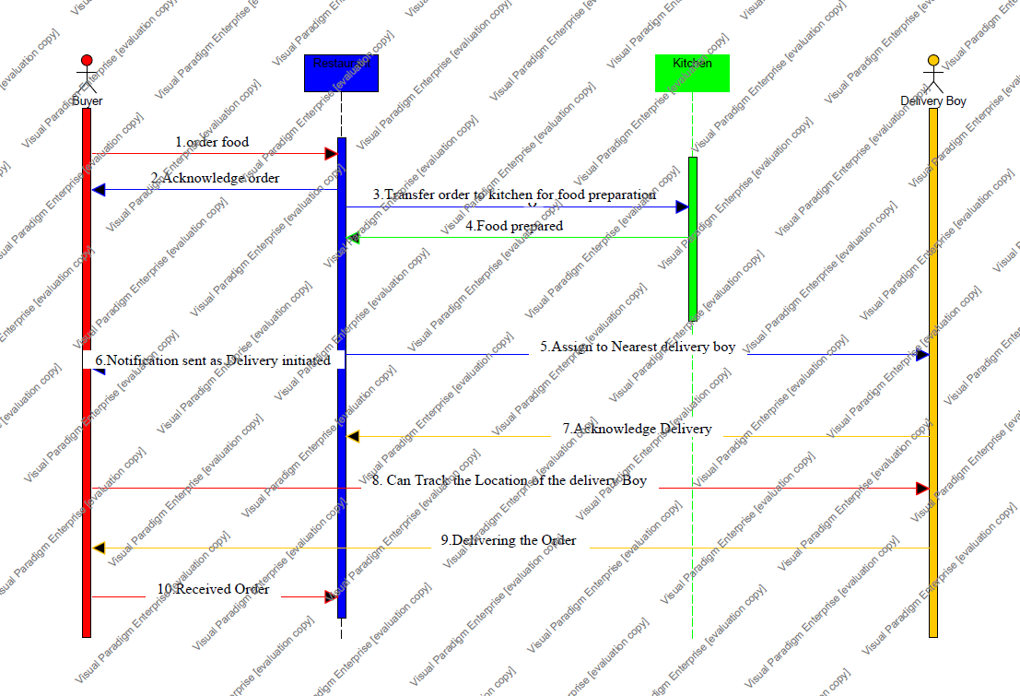
Sequence diagram

Slide 7
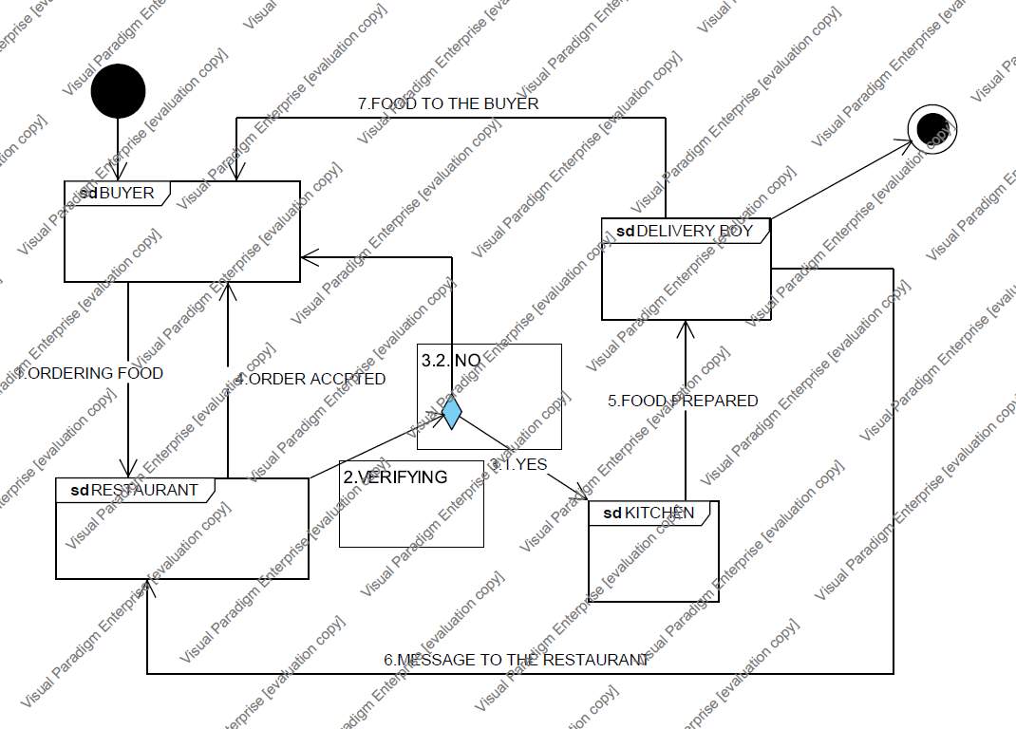
Interaction Overview
diagram

Slide 8
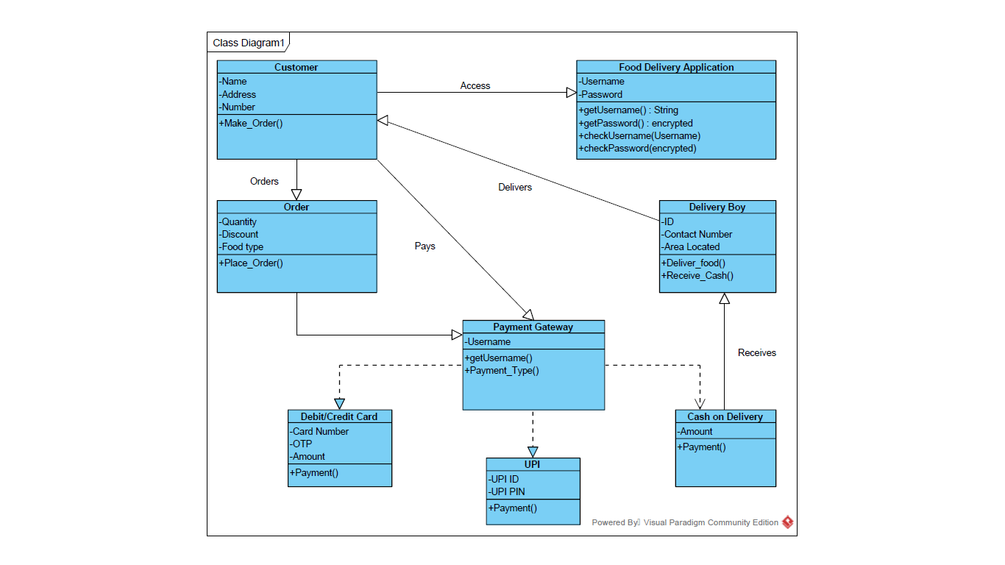
Class Diagram

Slide 9
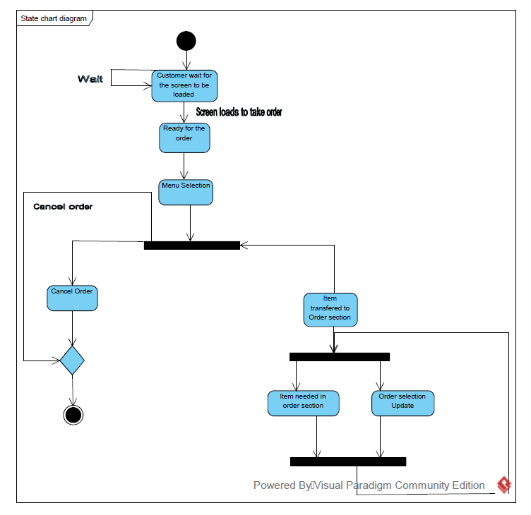
State chart diagram

Slide 10
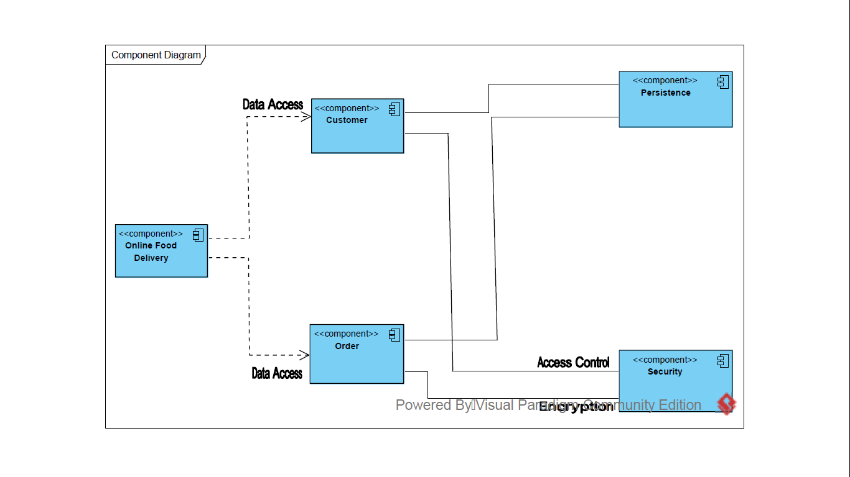
Component diagram

Slide 11
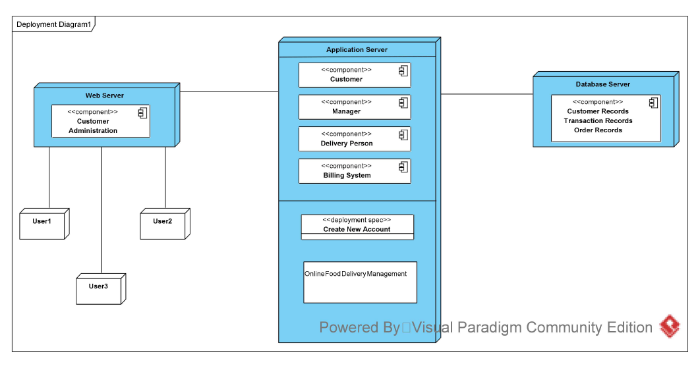
Deployment diagram

